Slide 1
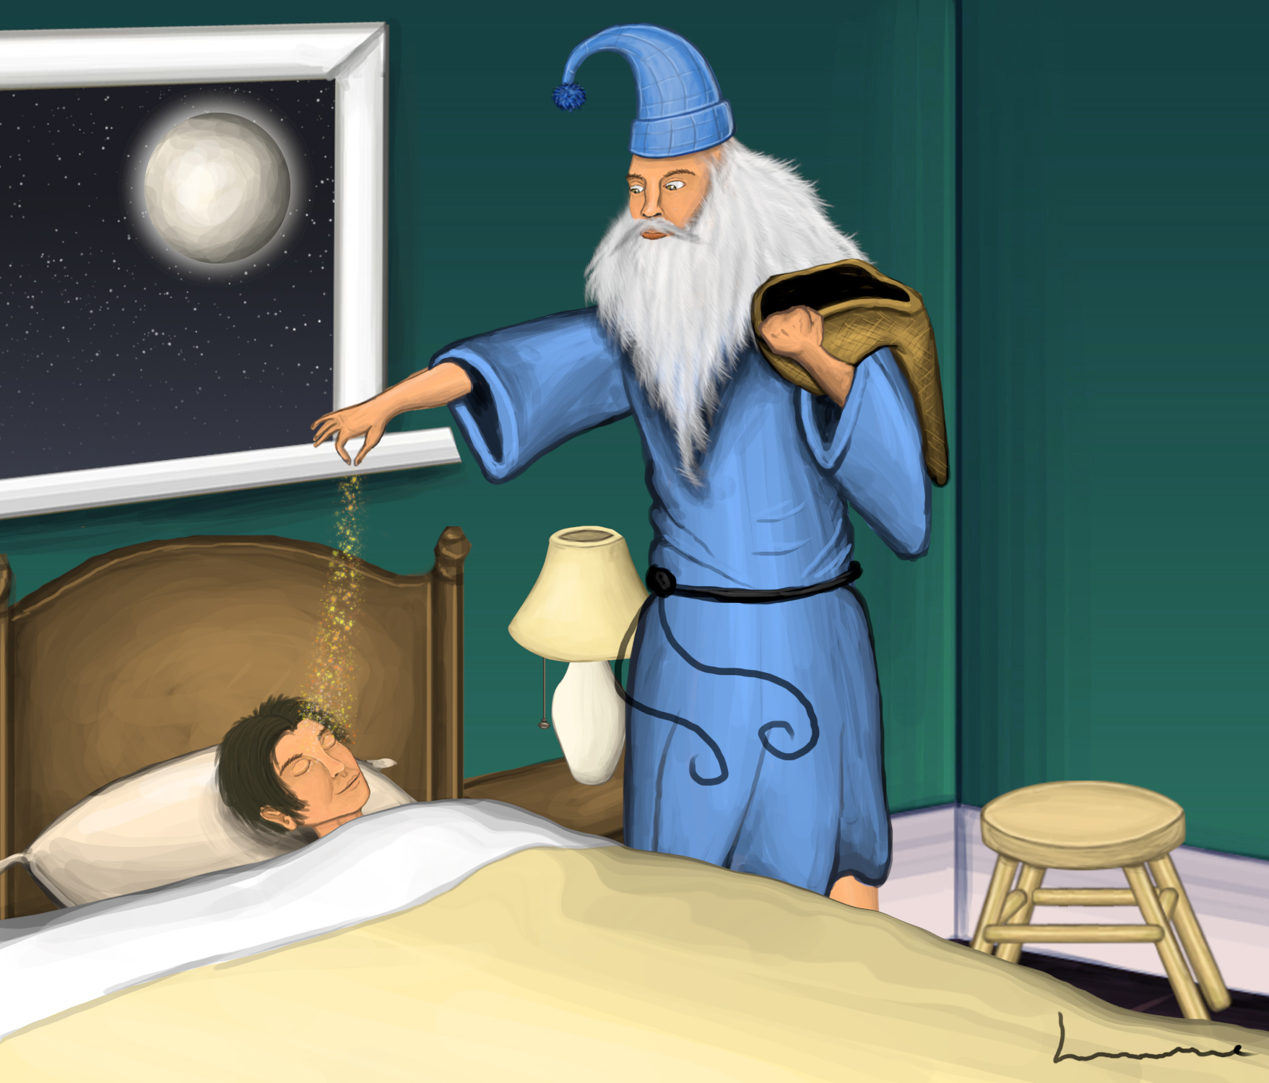
Slow Wave Oscillations and You:
Understanding what’s REALLY going on when you’re unconscious…

Slide 2
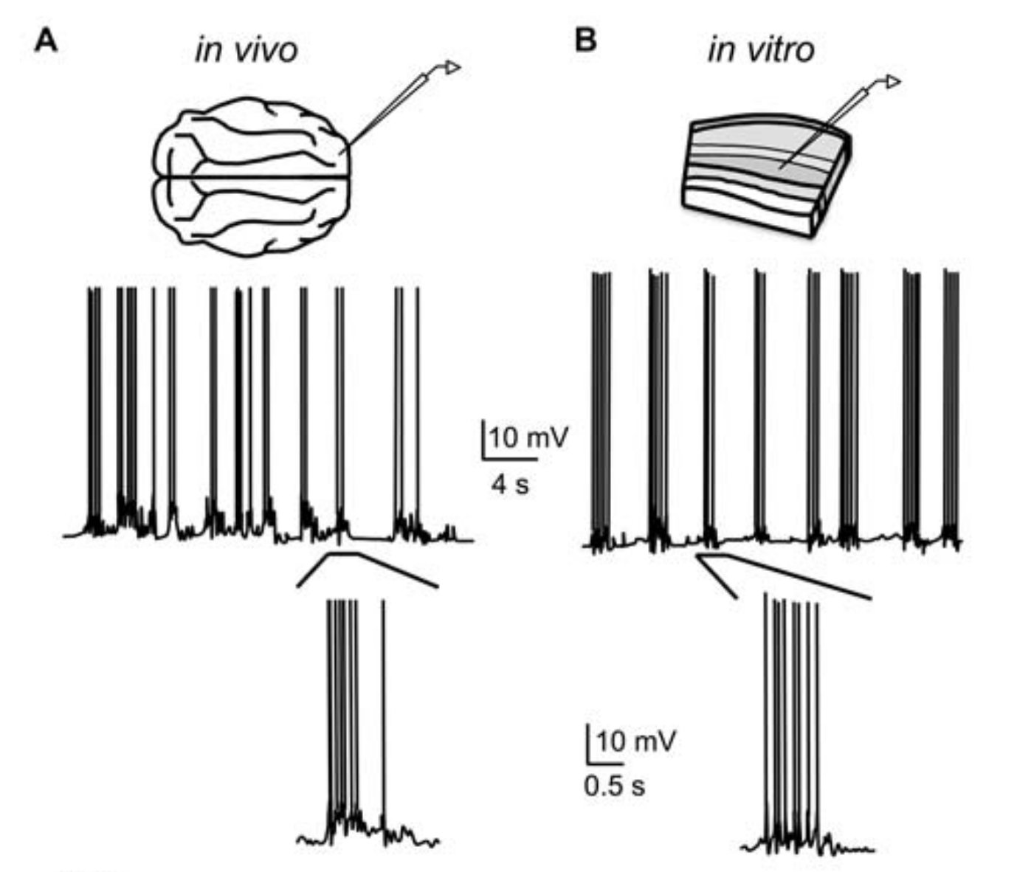
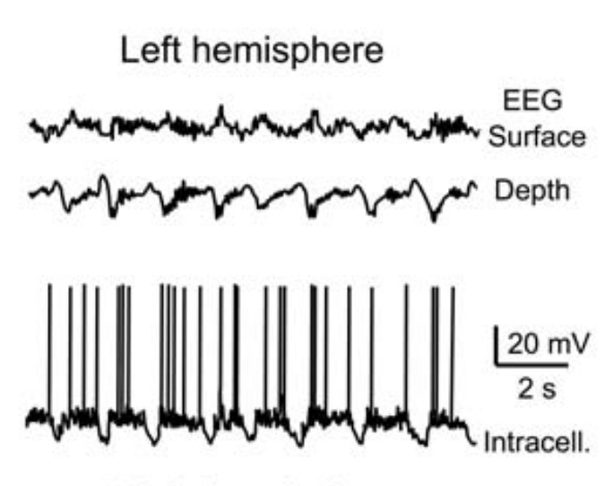
The year was 1993…(but also 1981 and 2000)
Ferret
CORTEX
Slice
Slow wave oscillations (“SWO”, 0.5 – 2.0 Hz) discovered in cortex
Early in vitro work suggested cortex was both ”necessary and sufficient”
(urethane)
Refs: Figs 1 and 2 of (Neske, 2016)

Slide 3
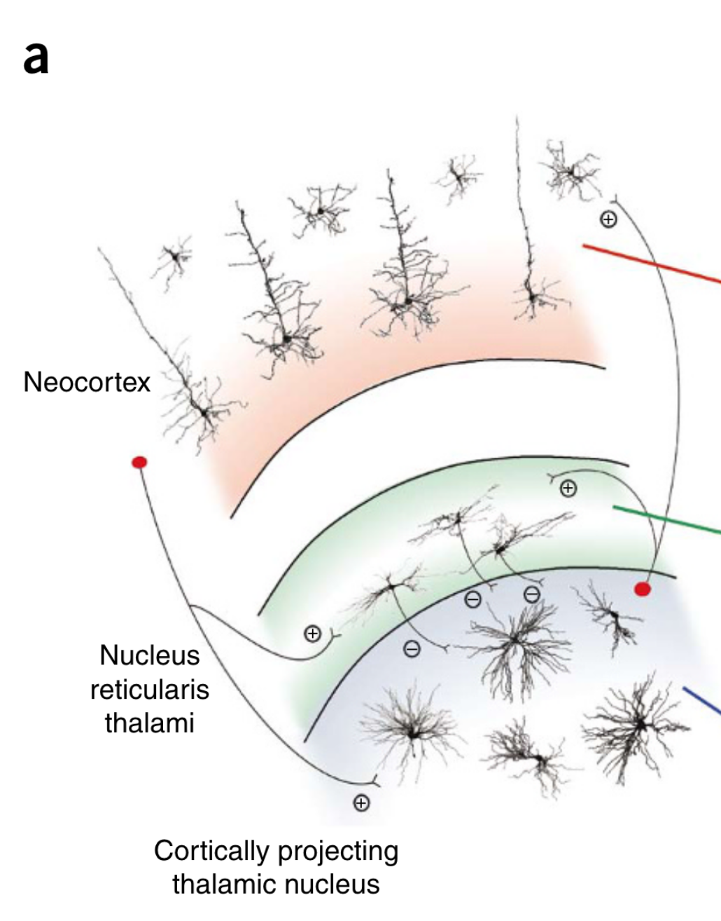
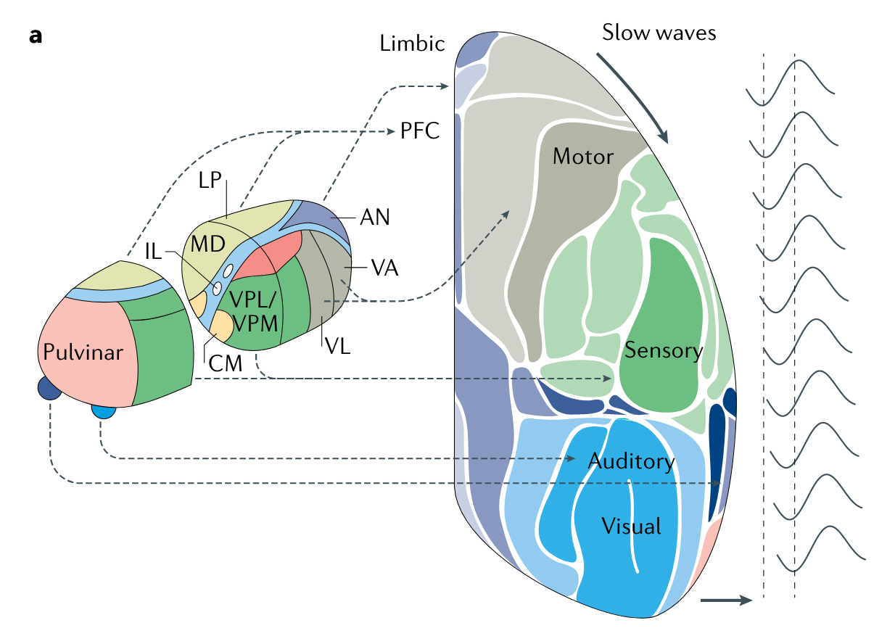
Modern thought: Cortico-thalamic
Entire cortex and thalamus participate
Thalamus helps to “coordinate” between cortical areas
Not shown but also important: brainstem nuclei (aka sources of neuromodulation)
Refs: Fig 1 of (Crunelli & Hughes, 2010), Fig 2 of (Adamantidis et al., 2019)

Slide 4
Sidepoint: SWO vs Delta
I’m going to be “loosey-goosey” about the distinction (or lack thereof) between SWO (0.5-2.0 Hz) and “delta” oscillations (traditionally 1-4 Hz).
In primates/humans experimental data, EEG-detected sleep SWO is closer to 0.5-2.0 Hz.
In rodent experimental data, in vivo intracranial electrodes (and EEG) detect slow sleep oscillations in the wider 0.5-4.0 Hz range. (SWO + delta)
(I can’t remember, but I believe this matches their faster respiratory rates etc.)
Most SWO computational models are only used to investigate 0.5-2.0 Hz, but are often capable of supporting oscillations in the delta range.
The biological mechanisms underpinning delta-specific models (for example, GABA-B) are probably shared with SWO mechanisms.
Refs: Untitled Goose Game

Slide 5
Sidepoint: SWO in sleep vs anesthesia
In general, most SWO research has assumed that there are no major differences between sleep SWO and anesthetic SWOs.
In the literature, experimental papers often report earlier SWO-relevant results as if they apply to both sleep and anesthesia, or do not discriminate between different anesthetics.
This is a problem.
I will try to indicate what anesthetic was used where, but it would be useful if someone took the SWO literature and classified it according to what species and anesthesia was used.

Slide 6
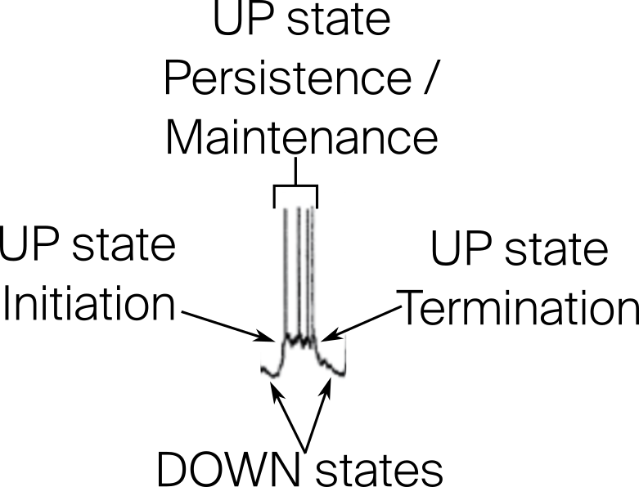
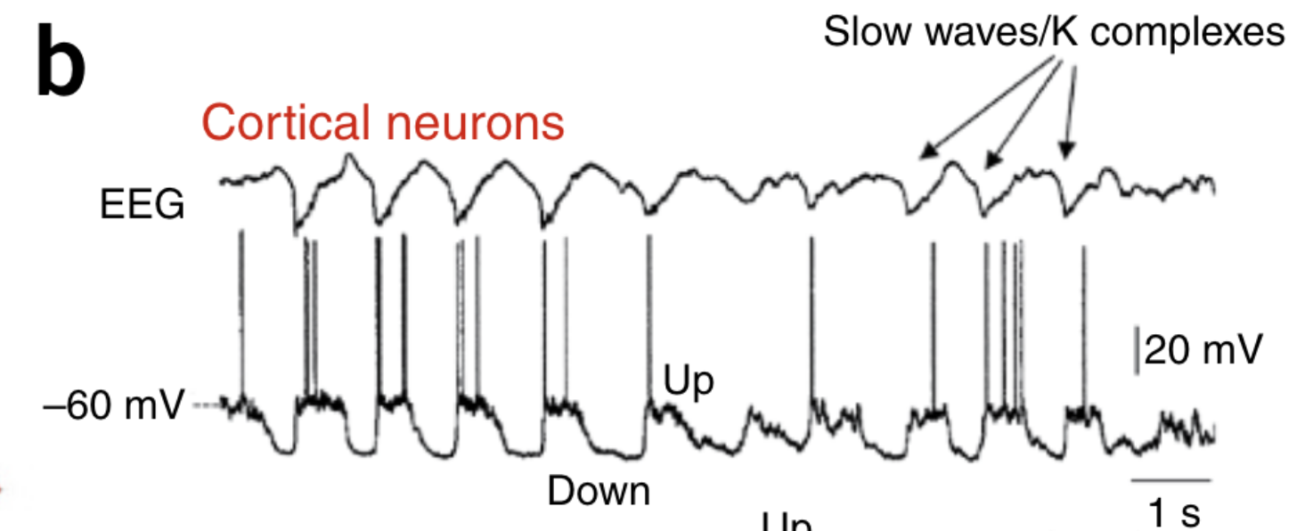
UP and DOWN states
Initiation = “DOWN-to-UP” transitions
Termination = “UP-to-DOWN” transitions
(ketamine-xylazine)
Refs: Fig 1 of (Crunelli & Hughes, 2010)

Slide 7
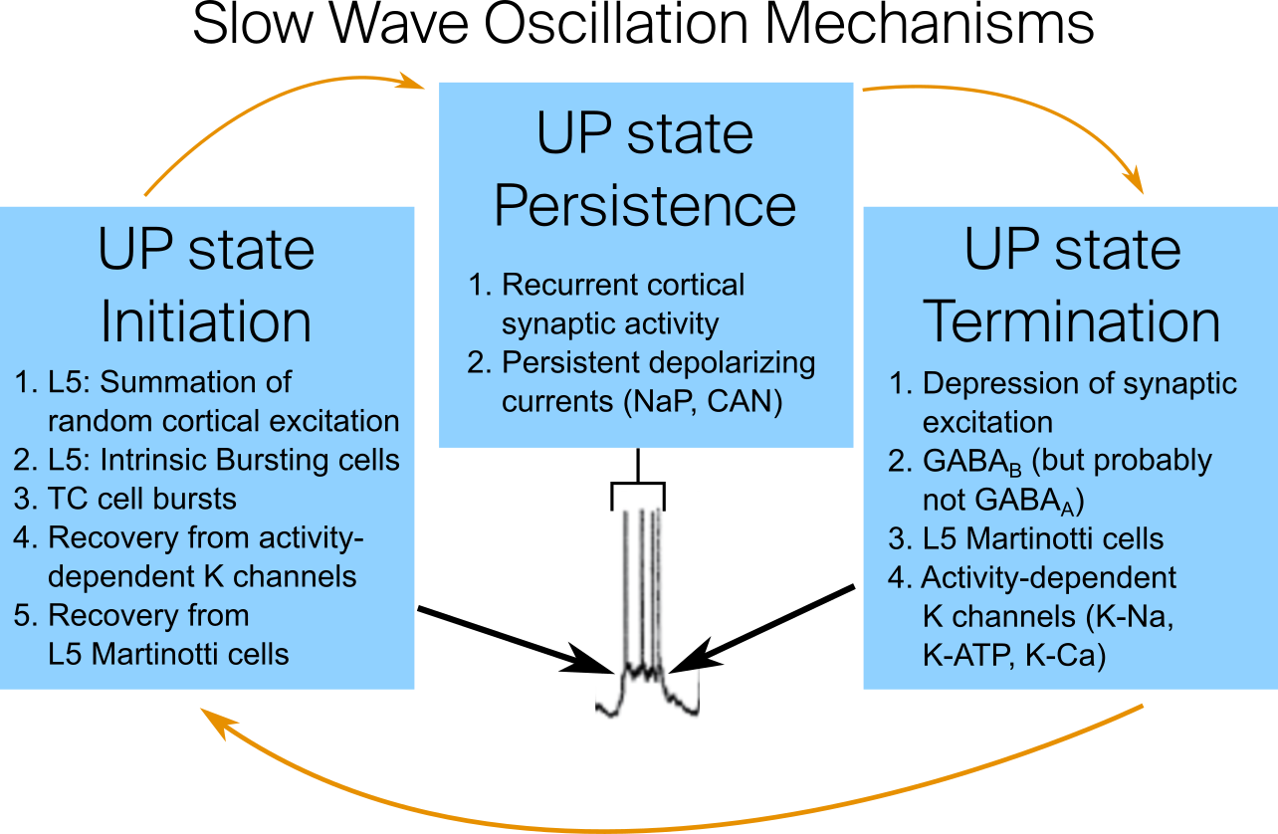
Word of the day: “Plurality”

Slide 8
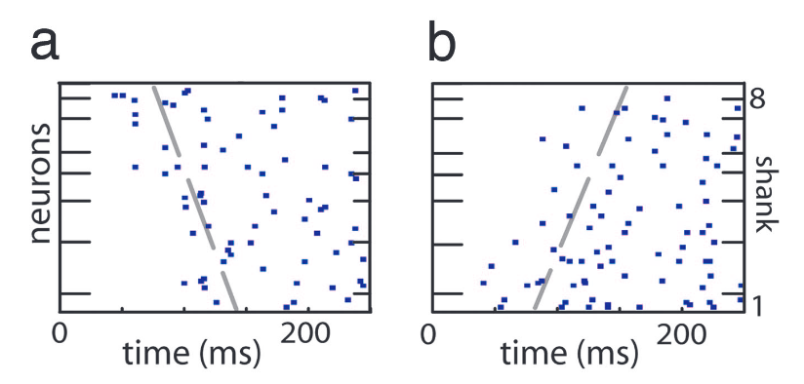
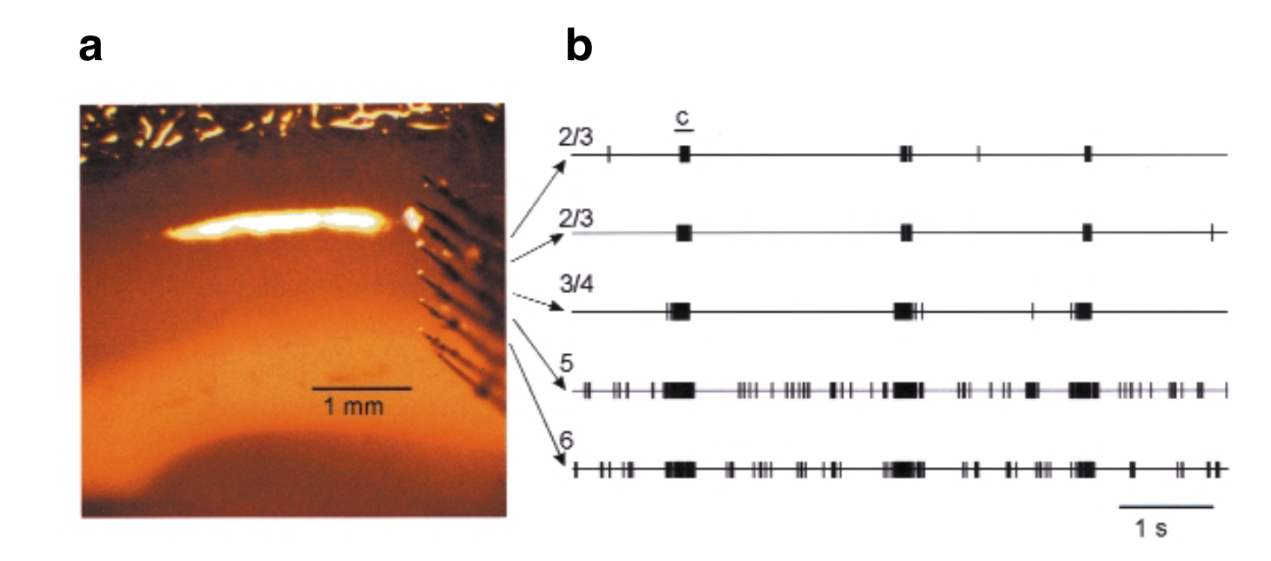
UP Initiation 1: Random L5 excitation
In vivo (urethane) (Luczak et al., 2007)
Evidence suggests that most cortical UPs first begin in exc L5 neurons
There are likely preferred, ”stereotyped” firing sequences
In vitro (Sanchez-Vives & McCormick, 2000)
Refs: Fig 2 of (Sanchez-Vives & McCormick, 2000), Figs 1 & 3 of (Luczak et al., 2007)

Slide 9
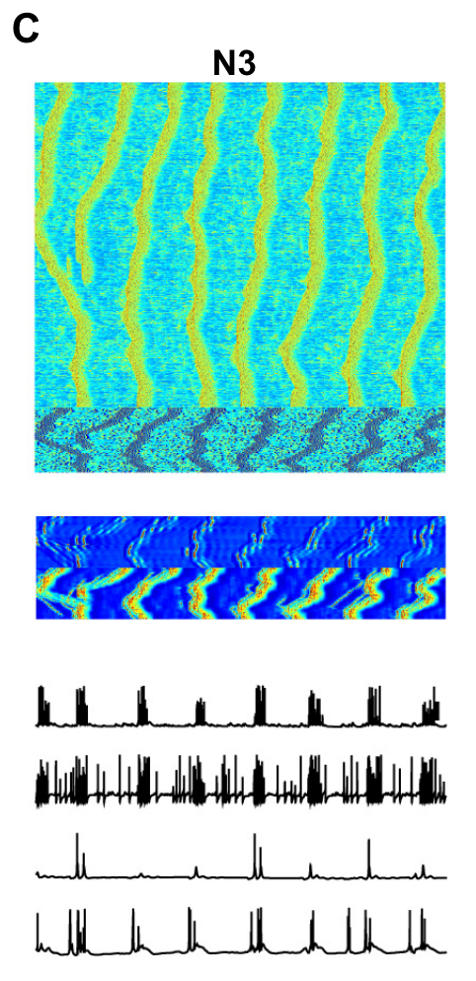
UP Initiation 1: Random L5 excitation
This has significant support from computational modelling (Maxim Bazhenov)
Modelled as originating from random AMPA synaptic “minis”
Refs: Fig 3 of (Krishnan et al., 2016)

Slide 10
UP Initiation 2: L5 Intrinsic Bursting cells
(Lorincz et al., 2015) title: “A Distinct Class of Slow (~0.2–2 Hz) Intrinsically Bursting Layer 5 Pyramidal Neurons Determines UP/DOWN State Dynamics in the Neocortex”
(Le Bon-Jego & Yuste, 2007) showed these pacemaker-like cells fire even under total synaptic blockade!
Refs: Fig 1 of (Lorincz et al., 2015)

Slide 11
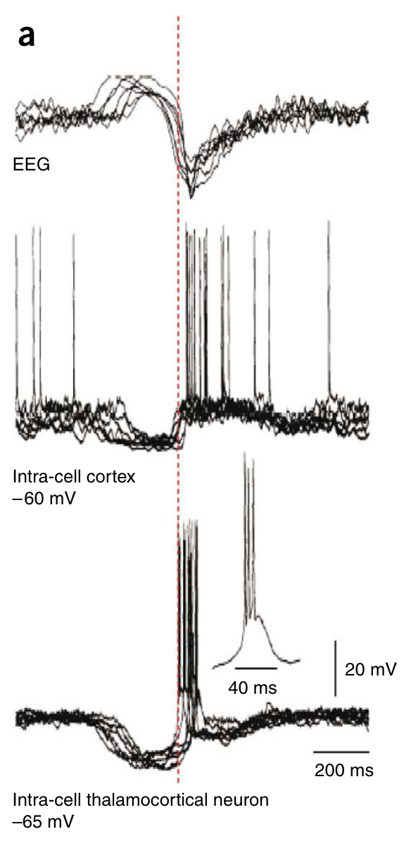
UP Initiation 3: Thalamocortical Cell bursts
TC bursts often precede cortical UPs by 20-50 milliseconds (shown right)
(Lemieux et al., 2014) used in vivo cat partial cat thalamo-cortical severance to show:
Decreased SWO frequency
Fewer fast oscillations (beta/gamma) during UPs
Decreased SWO synchronization across neurons
Rarely SWO abolishment
Other sources of decreased SWO frequency:
Pharmacological thalamus deactivation
T-type channel blocking in thalamus
In vivo cat
Refs: Fig 4 of (Crunelli & Hughes, 2010) from (Contreras & Steriade 1995)

Slide 12
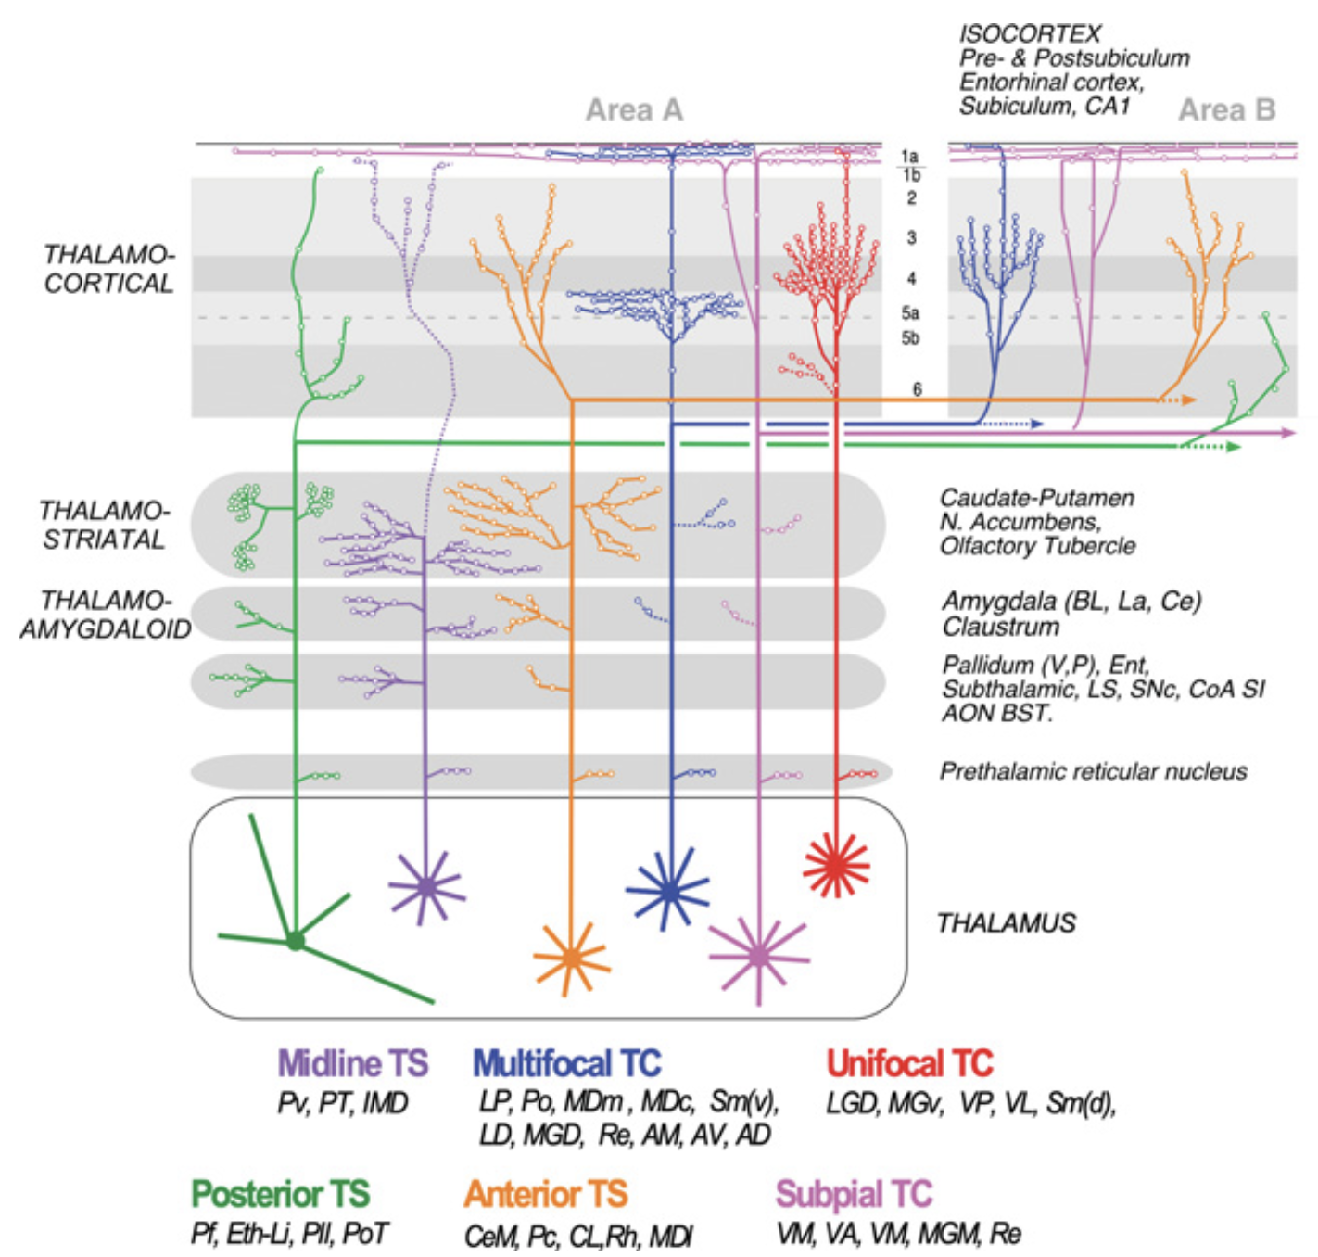
UP Initiation 3: Thalamocortical Cell bursts
Primary sensory (aka “core” or “first-order”) thalamocortical connections are widely known to project to L4 and L6
Most computational models include this connectivity
However, “matrix” or “higher- order” thalamocorticals project to L5.
Fewer models have included this
Therefore, UP initiation in L4/L6 vs L5 could help determine thalamic vs cortical origin
Thalamic bursts are a likely source of long-range cortical SWO spread, possibly anterior to posterior
See (Lorincz et al. 2015) for L2/3<->L5 SWO propagation
Refs: Fig 8 of Chapter 3 of Halassa, M (ed.), “The Thalamus” 2023
(originally from Clasca et al., 2012)

Slide 13
Persistence / Maintenance

Slide 14
UP Persistence 1: Recurrent synaptic activity
A consistent E/I ratio appears to be key
Evidence that this is the primary persistence mechanism:
Injecting current into cells doesn’t affect UP duration
Potential and spike variance is high during UPs
In vitro UPs are abolished by glutamatergic antagonists
This is closely tied with Termination, and I’ll be referring to this as the “E/I ratio hypothesis”
In vitro ferret cortex
Refs: Fig 3 (Neske, 2016)

Slide 15
UP Persistence 2: Persistent depol currents
”I_NaP”, the persistent sodium current, is present in the pacemaker-like L5IB cells
“I_CAN”, the Ca-dependent nonspecific cation current have been shown to exhibit “plateau potentials”
Much of the evidence for these currents lie in SWO models, especially NaP, which is widely used across SWO computational models
Part of the explanation for this may be that it is significantly easier to parametrize an intrinsic current for “persistent active activity” than to parametrize a connectivity for a consistent E/I ratio in simulations…
However, this is the less-likely persistence mechanism, owing to the high level of synchrony of UP Terminations (or UP-to-DOWN transitions)…

Slide 16
Termination (UP-to-DOWN transitions)

Slide 17
UP Termination 1: Excitatory depression
Over the course of an UP state:
Both excitatory and inhibitory Post-Synaptic Potentials decrease (Haider et al., 2006; Rudolph et al., 2007)
Input resistance increases (Contreras 1996)
There does not appear to be an increase in inhibitory cell activity at the end of an UP state.
This all suggests that Termination occurs in part due to excitation falling below some “threshold” needed for UP persistence.

Slide 18
UP Termination 2: GABA_{B}
Easy enough: (Neske 2016): "Progressive pharmacological blockade of [GABA_{B}] inhibition results in a continuous increase in UP state duration in vitro (Mann et al., 2009)”
However, progressive pharmacological blockage of GABA_{A} actually decreases UP state duration, in the same paper!
Me hypothesizing: this suggests there’s some adaptation or “slack” in UP state duration supported by slow synaptic processes, but not so much for short-term inhibition.
Possibility for anesthetic interaction: UP states in anesthesia are known to be much shorter than UPs in sleep. For GABA_{A}—potentiating anesthetics like propofol, this could be the reason.

Slide 19
UP Termination 3: L5 Martinotti cells
(Fanselow & Connors 2010) showed L5 fast-spiking interneurons, which are also pacemaker-like
These preferentially fire within the last 1/3rd of the UP state duration

Slide 20
UP Termination 4: Activity-dep K channels
Acetylcholine blocks activity-dependent K channels, including K-Na, K-ATP, and K-Ca
(Steriade et al., 1993) and others have shown that activating brainstem nuclei outputting ACh abolished UP-to-DOWN transitions
Computational model implementing these currents: (Compte 2003):
Similar to I_NaP, these are easy to simulate, BUT conflict with the high synchrony of UP-to-DOWN transitions across cortex
Refs: Fig 3 (Neske, 2016), from (Compte 2003)

Slide 21
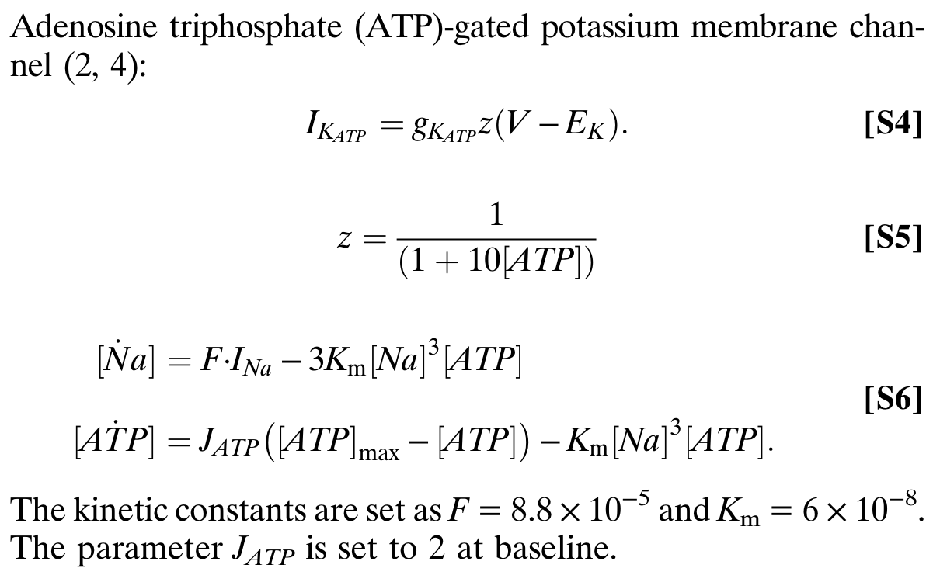
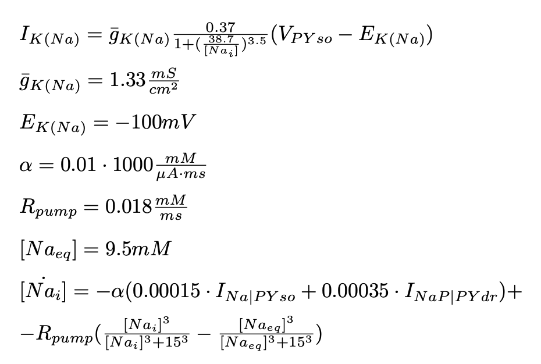
K-ATP
K-Na
Refs: (Ching et al., 2012) and (Soplata et al., 2023)

Slide 22
Discussion time?

Slide 23
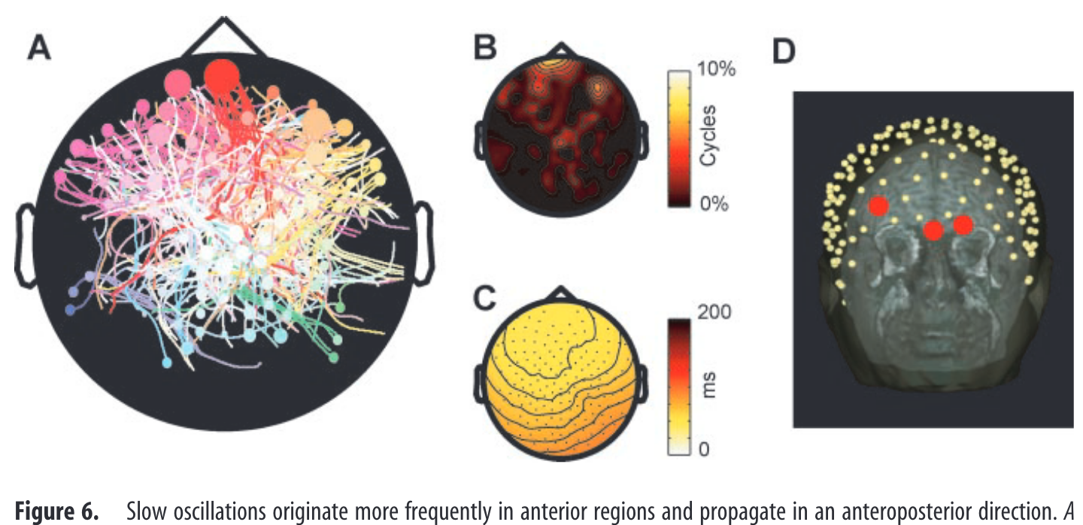
Refs: Fig 6 of (Massimini et al., 2004)

Slide 24
References
Key Reviews:
(Neske 2016) The Slow Oscillation in Cortical and Thalamic Networks: Mechanisms and Functions http://dx.doi.org/10.3389/fncir.2015.00088
(Crunelli & Hughes 2010) The slow (<1 Hz) rhythm of non-REM sleep: a dialogue between three cardinal oscillators https://www.nature.com/articles/nn.2445
(Sanchez-Vives 2020) Origin and dynamics of cortical slow oscillations https://doi.org/10.1016/j.cophys.2020.04.005
(Adamantidis et al., 2019) Oscillating circuitries in the sleeping brain https://doi.org/10.1038/s41583-019-0223-4

Slide 25
References (cont’d)
(Ching et al. 2012) A neurophysiological-metabolic model for burst suppression, www.pnas.org/cgi/doi/10.1073/pnas.1121461109
(Soplata et al., 2023) Rapid thalamocortical network switching mediated by cortical synchronization underlies propofol-induced EEG signatures: a biophysical model https://journals.physiology.org/doi/abs/10.1152/jn.00068.2022
(Sanchez-Vives & McCormick, 2000) Cellular and network mechanisms of rhythmic recurrent activity in neocortex http://www.nature.com/neuro/journal/v3/n10/abs/nn1000_1027.html
(Luczak et al., 2007) Sequential structure of neocortical spontaneous activity in vivo http://www.pnas.org/content/104/1/347.short
(Krishnan et al., 2016) Cellular and neurochemical basis of sleep stages in the thalamocortical network https://elifesciences.org/content/5/e18607v1
(Massimini et al., 2004) The Sleep Slow Oscillation as a Traveling Wave https://www.jneurosci.org/content/24/31/6862

Slide 26
References (cont’d)
(Le Bon-Jego & Yuste 2007) Persistently active, pacemaker-like neurons in neocortex http://www.ncbi.nlm.nih.gov/pmc/articles/PMC2518052/
(Lorincz et al., 2015) A Distinct Class of Slow ( 0.2-2 Hz) Intrinsically Bursting Layer 5 Pyramidal Neurons Determines UP/DOWN State Dynamics in the Neocortex http://www.jneurosci.org/cgi/doi/10.1523/JNEUROSCI.3603-14.2015
(Lemieux et al., 2014) The Impact of Cortical Deafferentation on the Neocortical Slow Oscillation http://www.jneurosci.org/cgi/doi/10.1523/JNEUROSCI.1156-13.2014
(Contreras & Steriade 1995) Cellular basis of EEG slow rhythms: a study of dynamic corticothalamic relationships http://www.jneurosci.org/content/15/1/604.short

Slide 27
Refs (cont’d)
Two types of slow waves in anesthetized and sleeping brains https://www.biorxiv.org/content/10.1101/430405v1
(Fiath et al., 2016) Fine-scale mapping of cortical laminar activity during sleep slow oscillations using high-density linear silicon probes https://www.sciencedirect.com/science/article/pii/S0165027018302565
(Clasca et al., 2012) Unveiling the diversity of thalamocortical neuron subtypes https://onlinelibrary.wiley.com/doi/abs/10.1111/j.1460-9568.2012.08033.x

